Slide 1
Hidden gems in SAS Enterprise Guide

Slide 2

Host
Vanessa Porter

Slide 3

Presenter
Peter Hobart

Slide 4

Managing the webinar
In Listen Mode
Control bar opened with the white arrow in the orange box

Slide 5
Key Features
Matrix
SAS / Enterprise Guide versions
 | 4.1 | 4.2 | 4.3 | 5.1 | 6.1 | 7.1
Split code window / project view | Y | Y | Y | Y | Y | Y
Stored process creation | Y | Y | Y | Y | Y | Y
SAS Report layout builder | Y | Y | Y | Y | Y | Y
Post - it style project notes | Y | Y | Y | Y | Y | Y
Conditional execution | N | Y | Y | Y | Y | Y
Code Autocomplete / syntax hints | N | N | Y | Y | Y | Y
SAS Code analyser (*enhanced) | N | N | Y | Y | Y* | Y*
Data Explorer | N | N | N | Y | Y | Y
Support for parallel execution | N | N | N | Y | Y | Y
Export data as an XLSX file | N | N | N | Y | Y | Y
Code re-layout on Ctrl+i | N | N | N | Y | Y | Y
Log summary window | N | N | N | N | Y | Y
Code Versioning | N | N | N | N | N | Y
Bitness | 32 | 32 | 32 | 32/64 | 32/64 | 32/64

Slide 6
Compatibility
Matrix
SAS / Enterprise Guide versions
 | 4.1 | 4.2 | 4.3 | 5.1 | 6.1 | 7.1
9.1 | Y | N | N | N | N | N
9.2 | L | Y | Y | Y | Y* | Y
9.3 | N | N | Y* | Y | Y | Y
9.4 | N | N | N | Y* | Y | Y
L : Limited support (Enterprise Guide and SAS on same host, no metadata)
* With appropriate hotfixes applied
Note SAS 9.4 is not supported on Windows XP
http://supportprod.unx.sas.com/kb/34/960.html

Slide 7
Gem 1
Characterise Data task
Generates basic information about a table
  Frequency counts
  Summary of variables by type
    Numeric
    Currency
    Date
  Including statistics n, nmiss, min, mean, median, max…
  Histograms of value distribution

Slide 8
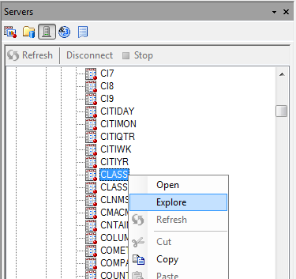
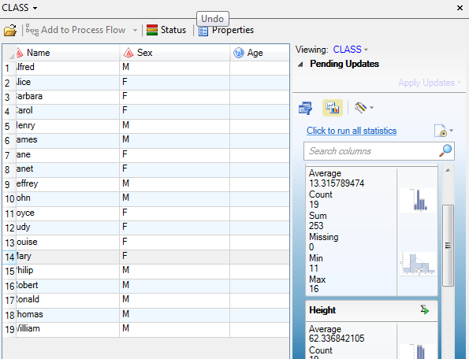
Gem 2
Enterprise Guide Explorer (5.1)
Filter the data view by value
Generates "Quick statistics" for selected variables

Slide 9

Gem 3
Search current project (7.1)
Search for a value anywhere in the current project
  Programs
  Tasks
  Reports
  Data
  Queries
  Stored Processes
  Cubes
  Logs
  Notes
Items searched can be specified

Slide 10
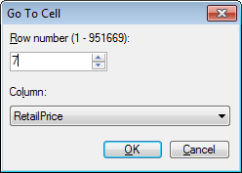
Gem 4
gO TO.. IN THE DATA TABLE
If the data table has focus then Ctrl+G brings up the go to.. dialog
Specify a row number to go straight there.
The selected column's value will be highlighted
Also:
Ctrl+Home - go to first record
Ctrl+End - go to last record

Slide 11
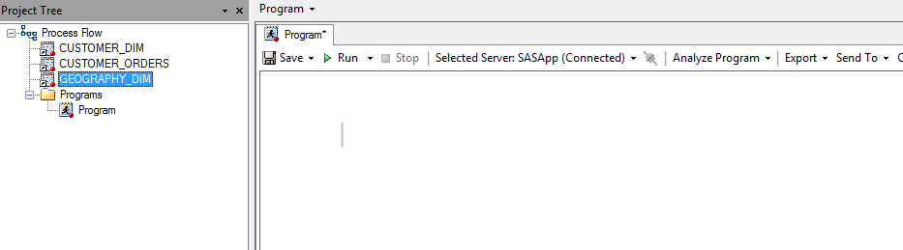
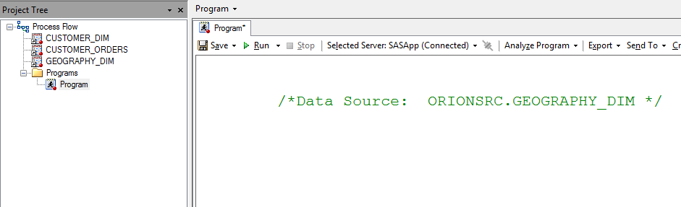
Gem 5
Drag a table from the project tree onto a program
Adds the full name of the table inside a comment.
Drag the name into your code as needed

Slide 12
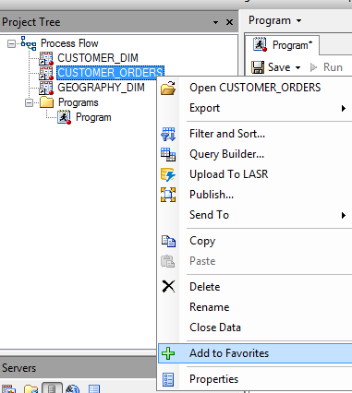
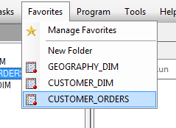
Gem 6
Favourite items
Creating favourite data items makes it quicker to add them to a new project

Slide 13
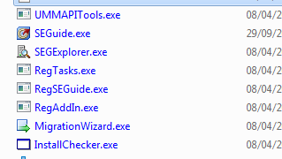
Gem 7
Bulk Migration wizard
The migration wizard is installed by default in the same folder as Enterprise Guide
It allows bulk changes to server names / paths etc
Use it to update multiple projects during migration and system updates
Notes:
For example SASMAIN > SASAPP on migration from SAS 9.1 to later versions

Slide 14
Gem 8
Auto - update (7.11)
SAS Enterprise Guide 7.11 checks for newer versions and offers to apply them automatically
Options to:
    Install now
    Remind me later
    Skip the update

Slide 15
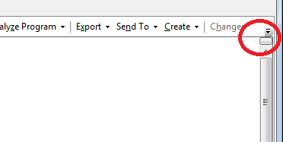
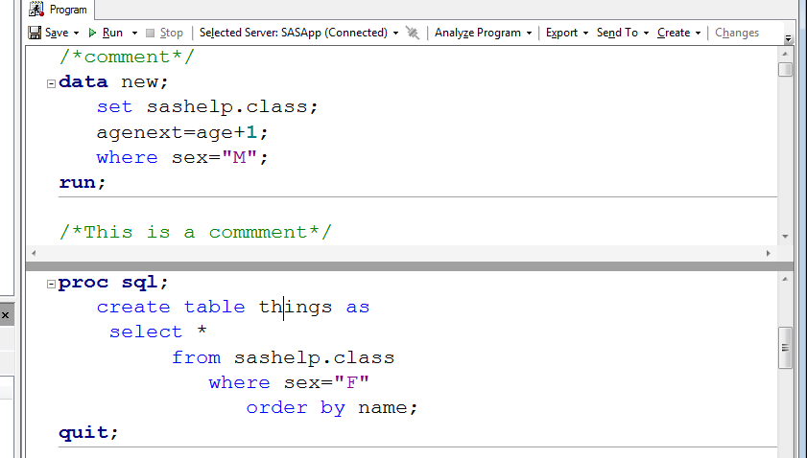
Gem 9
Multiple views in the code window
The "Split" gadget allows a program window to show two sections of the same code.

Slide 16
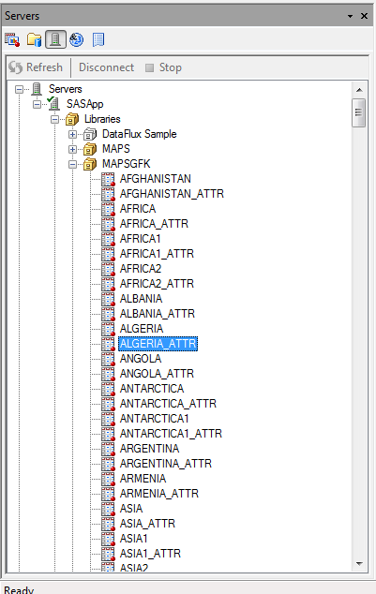
Gem 10
Multiple views in the sidebar
By default only one item is displayed
Clicking on new item closes the existing item

Slide 17
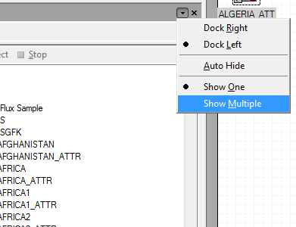
Gem 10
Multiple views in the sidebar
Selecting show multiple allows many items to be open

Slide 18

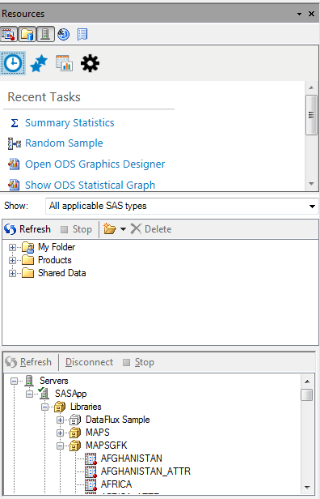
Gem 10
Multiple views in the sidebar
Here three items are selected
All are displayed in the resource pane

Slide 19
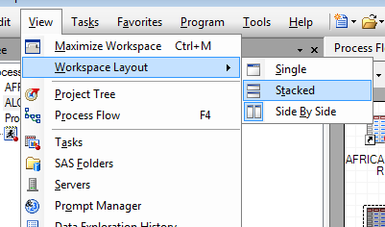
Gem 11
Multiple views in the project window
Choose the preferred arrangement

Slide 20
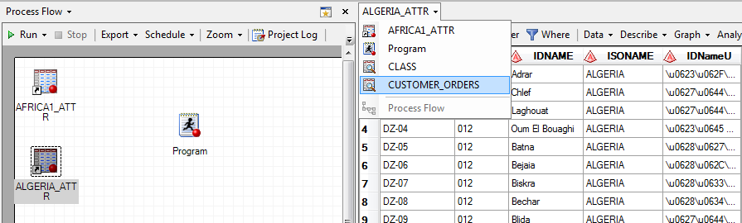
Gem 11
Multiple views in the project window
Each window can display any project item

Slide 21
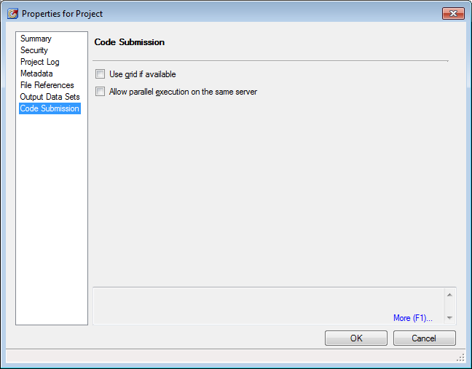
Gem 12
Parallel execution
Set under File > Project Properties
Allows independent flows in a project to run in multiple SAS server sessions
To prevent surprises, ensure there are no dependencies between the flows. For example, each session will have a different WORK library so temporary tables cannot be shared

Slide 22
Gem 13
Enterprise Guide add-ins
  SAS catalog explorer
  SAS system options viewer
  Macro variable viewer
  Project reviewer
  Task property viewer
  Message prompt
  Calculate data cardinalities
  Copy files to / from server
  Squeeze SAS data set
  SAS Copy column names (to clipboard)
  Create a data step from a data set
  Sudoku solver
See http://blogs.sas.com/content/sasdummy/2013/11/25/11-custom-tasks/

Slide 23
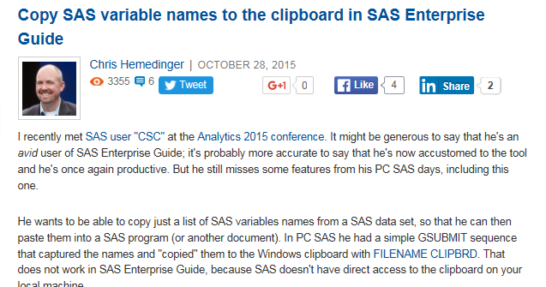
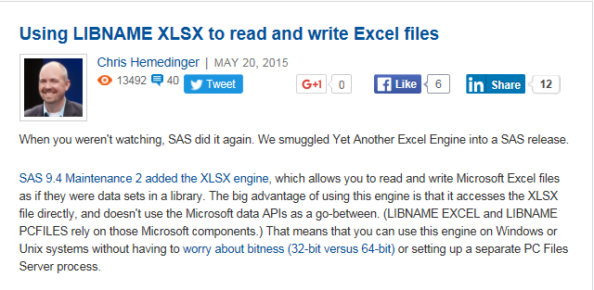
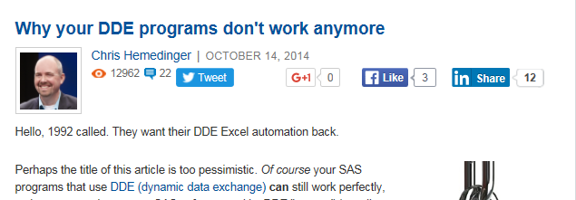
Gem 14
The SAS dummy
Chris Hemedinger's blog on SAS, with a lot of Enterprise Guide content
  Chris is a developer of Enterprise Guide
  Chris has authored many Enterprise Guide add-in tasks
Notes:
Search on "SAS dummy" to find Chris's blogs.
Hemedinger will probably work too

Slide 24
Thankyou for attending

Slide 25
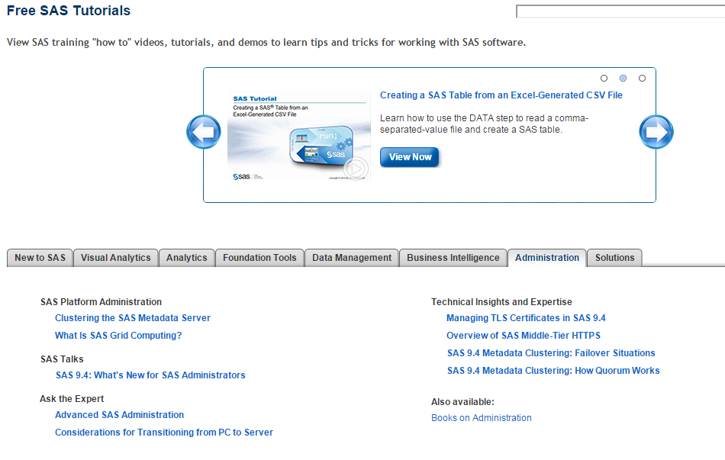
SAS platform administration
Free SAS Tutorials
More information and sources of help

Slide 26
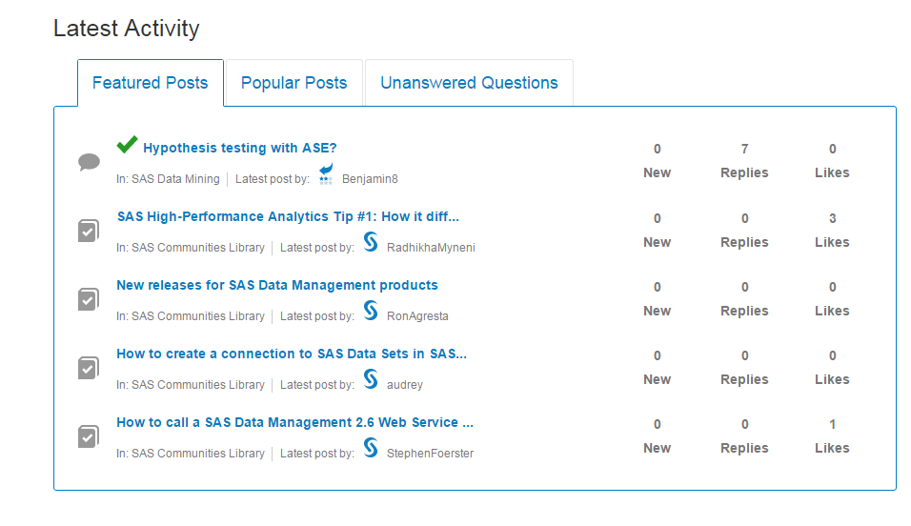
Sas communities

Slide 27
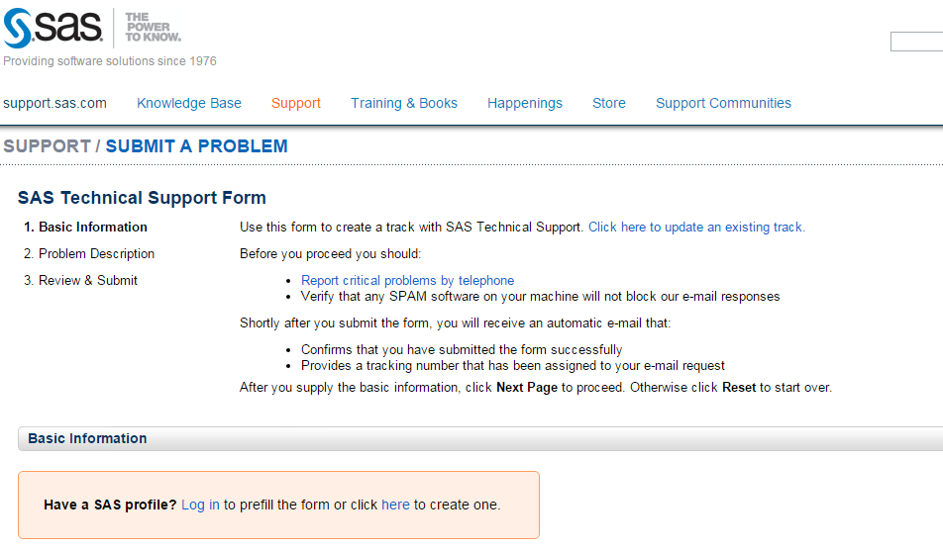
Raising a track
SUPPORT.sas.com
SAS Technical Support

Slide 28
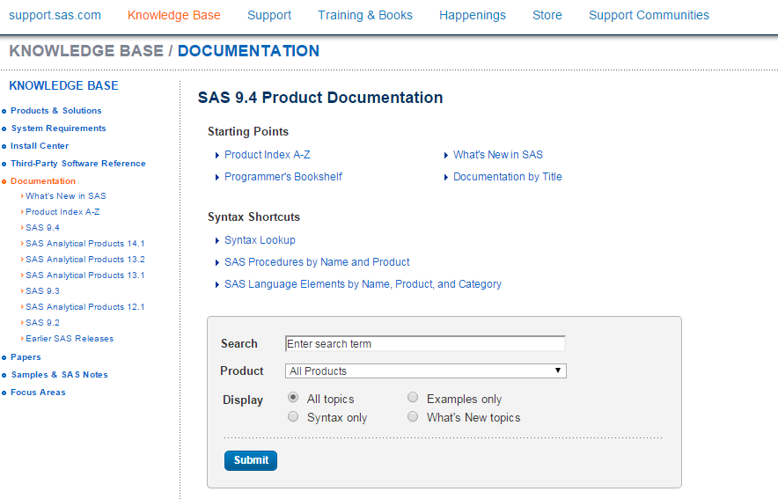
Where to go for help

Slide 29
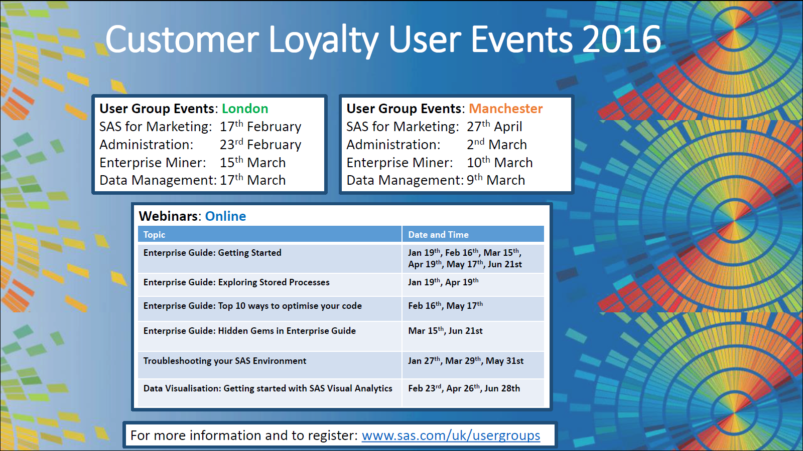
SAS User Groups
www.sas.com/uk/usergroups
Platform Administration
23rd February 2016 – London
2nd March 2016 – Manchester

